Slide 1
Fabrication & Prototyping in learning Lab
By:
Gunakar Challa

Slide 2
Global Project - Surveillance Robot
A robot does the automated surveillance in a designated area. During the surveillance, when it recognises an unauthorised person in the area, it shall alert follow the person and alert him/her about the trespassing.
Send the surveillance stream to the security admin.
Control the Robot remotely when needed.

Slide 3

The Gain:
Less operating cost.
Adaptable to extreme whether conditions.
Extendable to large areas.
Takes less time even there are several people to scan through..
Can store data regarding large number of people.
The Pain:
Might be less reliable when compared to humans.
Huge setup costs and training costs.
Unpredictability in occurrence of untrained scenarios.

Slide 4
Prototype
The prototype is realised using PMB2 robot base and Raspberry Pi.
The robot does the surveillance in the map using Navigation goals and AMCL pose estimation.
A webcam is connected to the Pi and the Pi is attached to the Robot.
The Raspberry Pi helps to navigate robot through the area as well as scan through the area using OpenCV pose landmarking machine learning model.

Slide 5
Prototype
Once it detects any human, it stops the surveillance mode and activates the approach human mode, where in it calculates the next navigation goal using trigonometric equations.
While moving it verifies whether it has reached the goal point using AMCL pose data.
Once it reaches the goal it recalculates the new navigation goal assuming the human has moved.
This process continues until the human distance threshold value is reached.
Once the threshold value is reached it plays the alerting sound.

Slide 6
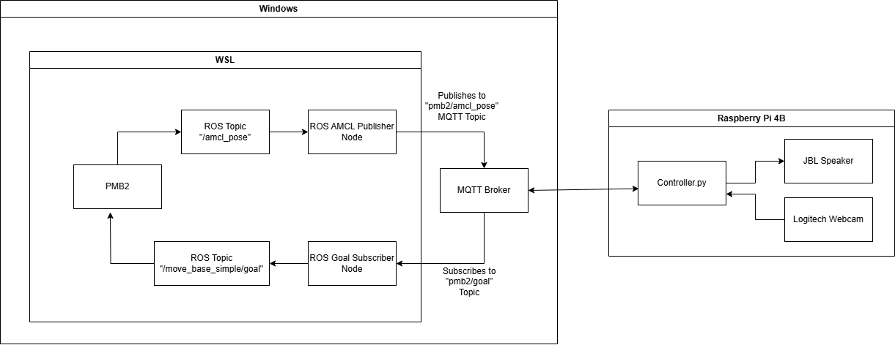
Architecture

Slide 7
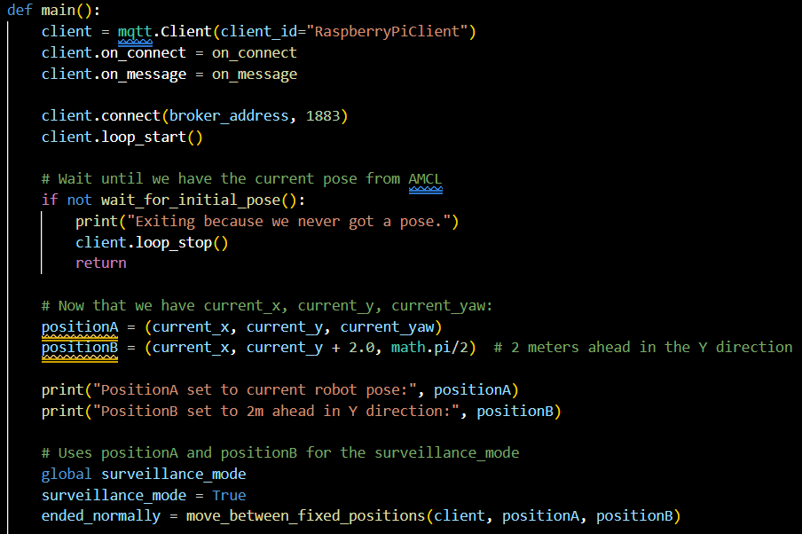
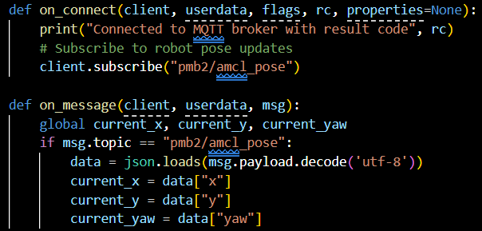
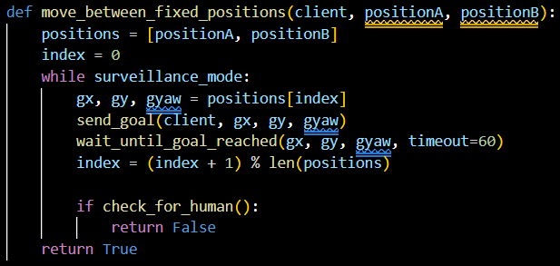
Logic –Surveillance Mode
Main function (part 1)

Slide 8
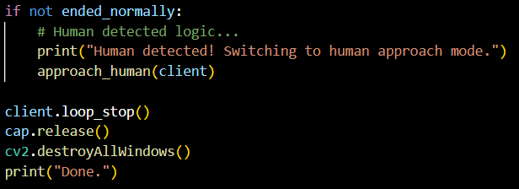
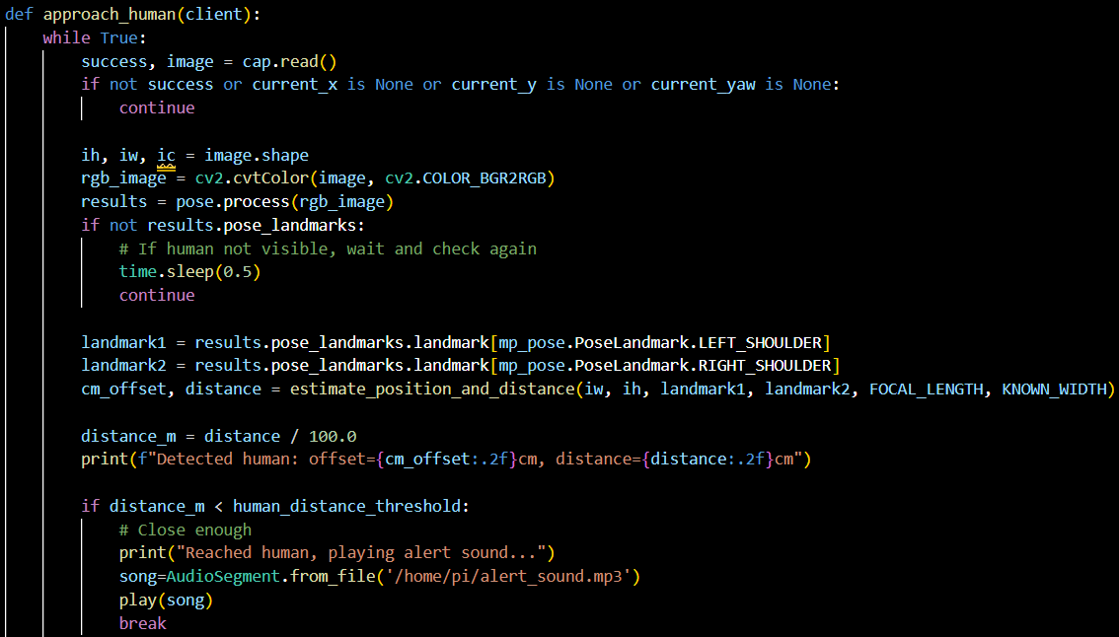
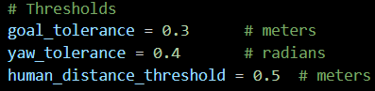
Logic – Approach Human mode
Main function (part 2)
Approach Human function (part 1)

Slide 9
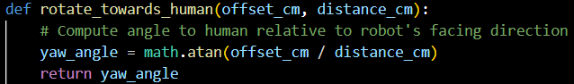
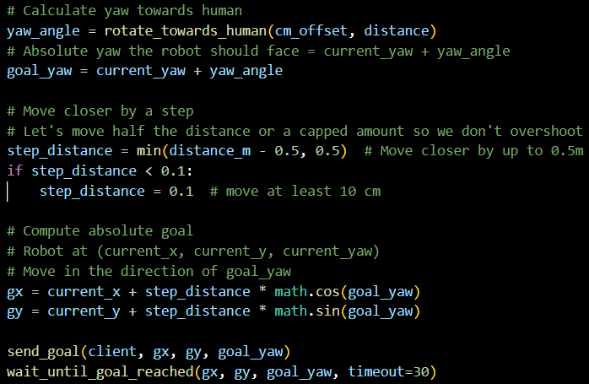
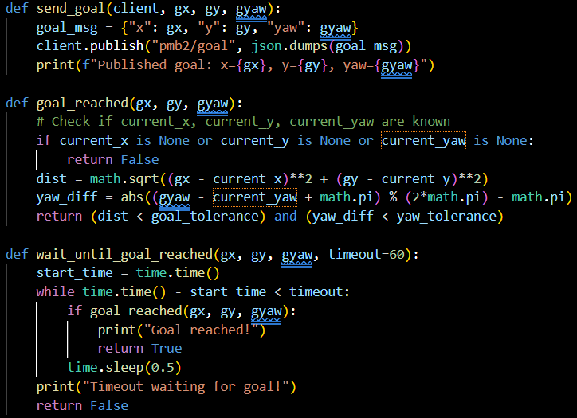
Logic – Approach Human mode continuation
Approach Human function (part 2)

Slide 10
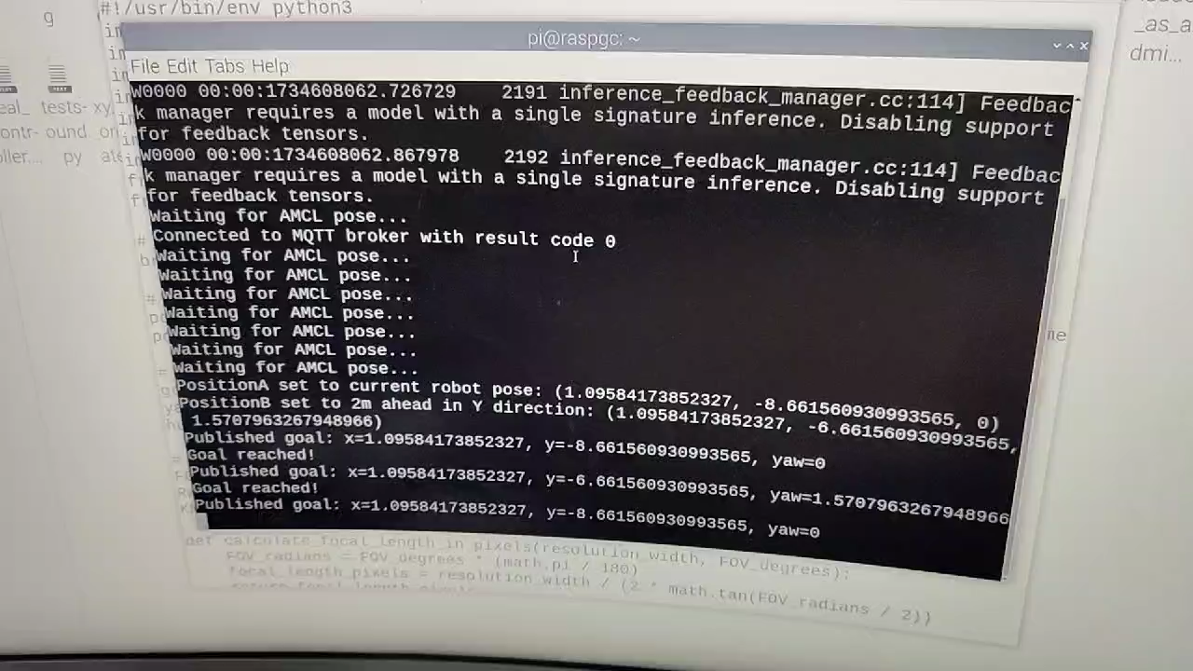
Demo Video

Slide 11
Limitations
The calculations are dependent on the values obtained from the OpenCV machine learning model, which is not accurate enough.
The problem of False Positive and True Negative with the model.
Currently checking for humans after a goal is reached, but not parallelly. For this we need to implement it via multithreading. Or else we need to run parallel programs and establish synchronous communication between the programs.
Currently using detection instead of recognition model. This is would alert even authorised personnel.

Slide 12
Prototype to Global Project
Usage of IR camera instead of normal camera for added safety during surveillance.
Adding mechanisms to send & receive audio streams from the robot instead of playing generic audio file.
Using sensors to collect the data instead of relying on data received form the model.
Sending the surveillance stream to the security department or administration.

Slide 13
Prototype to Global Project
Implementing the same via multithreading.
Adding mechanisms to take control of the robot when needed.
Using recognition model instead of detection model.

Slide 14
Thank You! Any Questions?

